Slide 1
Volatile Functionality in Action: Methods, Techniques and Assessment
Darian Frajberg, Politecnico di Milano - Italy
Matías Urbieta, University of La Plata - Argentina
Gustavo Rossi, University of La Plata - Argentina
Wieland Schwinger, Johannes Kepler University - Austria

Slide 2
Introduction and motivation
Continuous evolution and dynamism of current Web Applications
Emergence of new requirements after deployment within maintenance stage
Emergent functionalities
Permanent functionalities
Volatile functionalities (VFs)
Impact of incorporation and removal of VFs during maintenance phase
Code quality
Times
Costs

Slide 3
Example - Black Friday in Amazon

Slide 4
Objectives
Alternative implementation for Web Applications with VFs
Efficient support for the management of VFs
Analysis of possible methods and techniques for the implementation with different technologies
Development of prototypes
Assessment

Slide 5
VF Framework
Conceptual and technological Framework
Permits to improve the lifespan of VFs in Web Applications
Automates the processes of activation and deactivation of VFs
Based on two main principles
Decoupling of VFs from the original application
Possibility to schedule the activation and deactivation of VFs

Slide 6
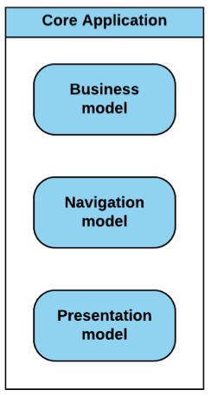
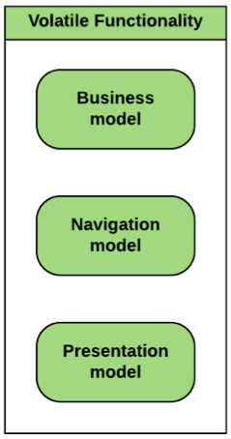
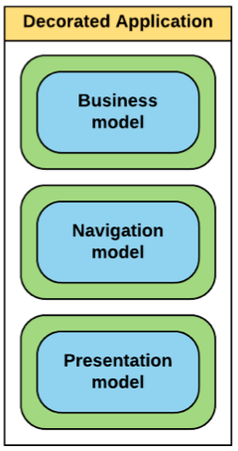
Our approach - key concepts

Slide 7
Features required for supporting VF approach
Weaving approach
Business model enhancement
Navigation model enhancement
Presentation model enhancement
Lifespan management

Slide 8
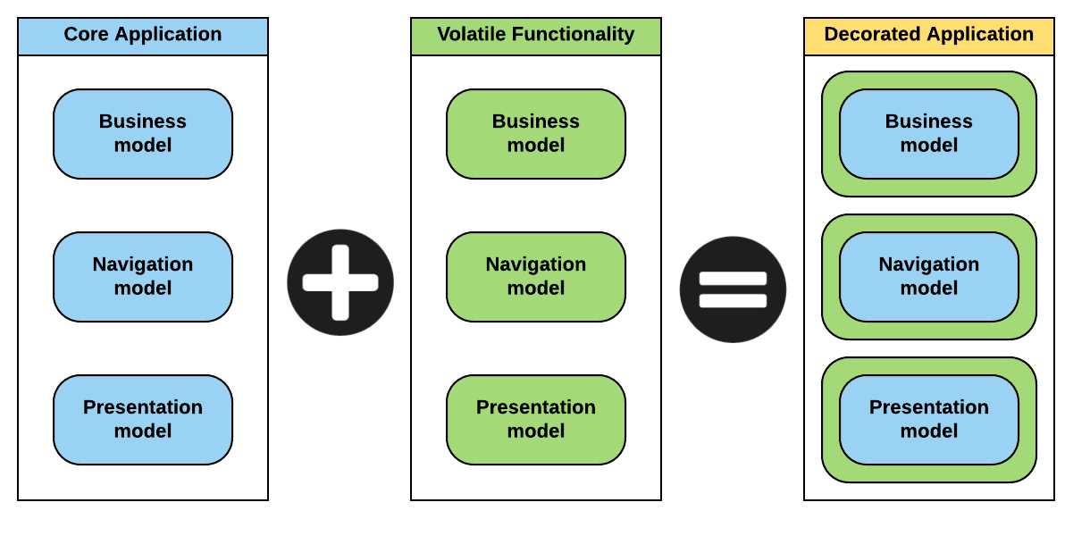
Weaving approach
Transparent seamless integration between Core Application and VFs
Weaving mechanism

Slide 9
Weaving approach
Alternatives
Strategy | Applicability conditions | Implementation example
Static | Static type binding | Maven
Dynamic | Dynamic type binding | Reflection

Slide 10
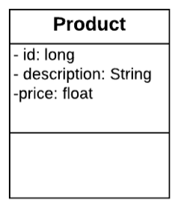
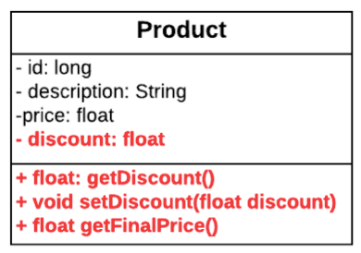
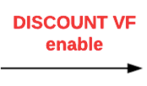
Business model enhancement
Injection of variables and relationships
Object-Relational Mapping (ORM of variables and relationships)
Injection of methods
Modification of methods

Slide 11
Navigation model enhancement
Injection of dependencies
Injection of methods
Modification of methods

Slide 12
Business & Navigation model enhancement
Alternatives
Strategy | Applicability conditions | Implementation example
Aspect-Oriented Programming (AOP) | Methods interception | AspectJ, PHANtom
Regex modifications | Interpreted code execution | Pharo native support

Slide 13
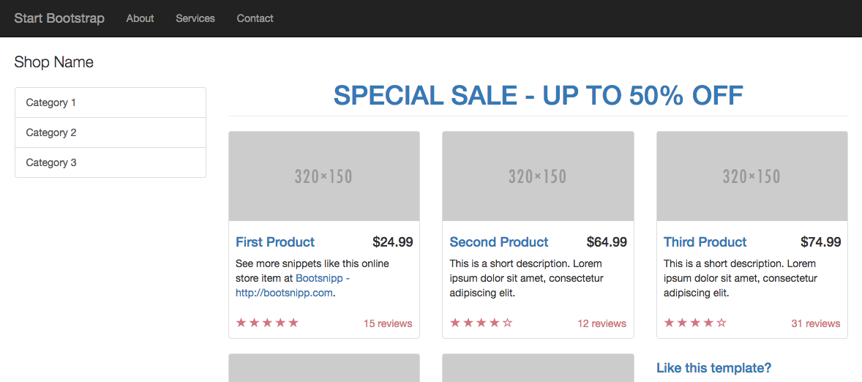
Presentation model enhancement
Visualization of modifications dependent on VF’s state
SALE VF ACTIVATED

Slide 14
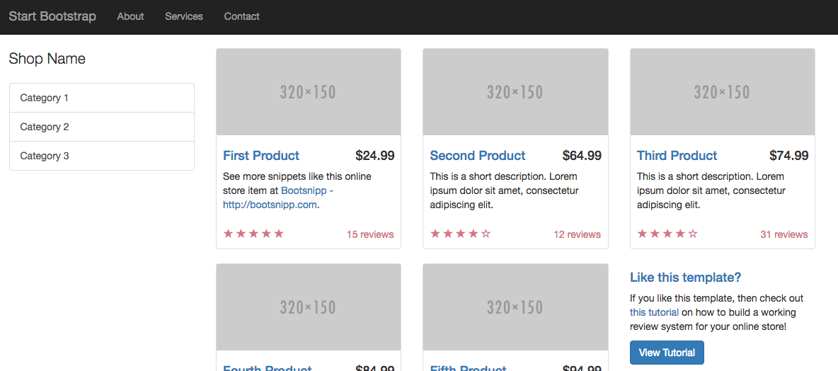
Presentation model enhancement
Visualization of modifications dependent on VF’s state
SALE VF DEACTIVATED

Slide 15
Presentation model enhancement
Alternatives
Strategy | Applicability conditions | Implementation example
Documents transformation | Document-based UI | XSLT
Aspect-Oriented Programming (AOP) | Methods interception | AspectJ, PHANtom
Regex modifications | Interpreted code execution | Pharo native support

Slide 16
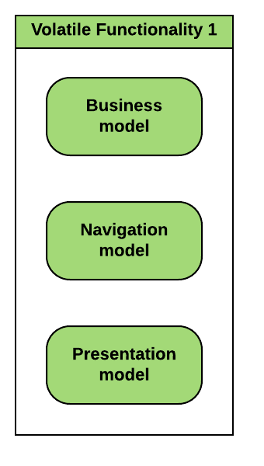
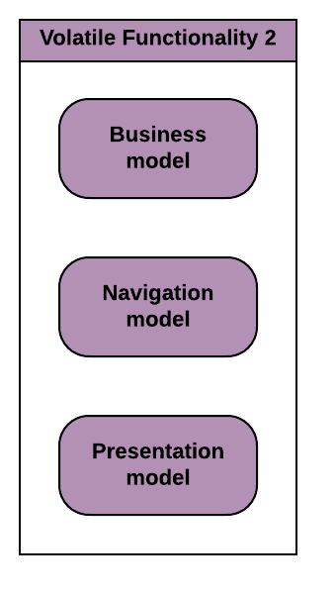
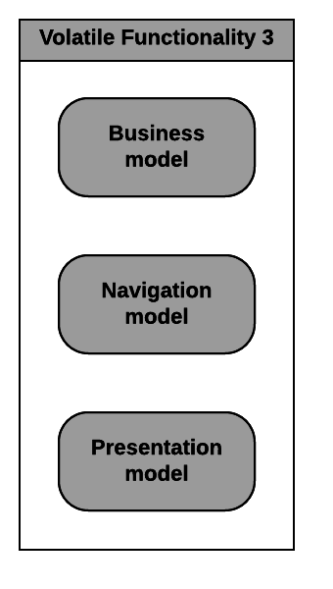
Lifespan management
Event scheduler
Events scheduling
Temporal events
Business events
Temporal business events

Slide 17
Lifespan management
Event scheduler
Events scheduling
Temporal events
Business events
Temporal business events
Activate on
10/06/2016 12:00 AM

Slide 18
Lifespan management
Event scheduler
Events scheduling
Temporal events
Business events
Temporal business events
Deactivate when
productA.stock = 0

Slide 19
Lifespan management
Event scheduler
Events scheduling
Temporal events
Business events
Temporal business events
Activate on
10/06/2016 12:00 AM
when
productB.stock < 100

Slide 20
Lifespan management
Alternatives
Strategy | Applicability conditions | Implementation example
Rules-engine based | Mature enterprise solutions | Drools
Scheduler and AOP based | Restricted development kit | Quartz

Slide 21
Smalltalk prototype
Sushi store Web Application sample with two VFs:
Discount
3x2 promotion
Implementation:
Weaving approach: Dynamic weaving with Reflection
Business & Navigation model enhancement: AOP with PHANtom & Regex modifications
Presentation model enhancement: Regex modifications
Lifespan management: Scheduler and AOP based
White box Framework for VFs management

Slide 22
Java Prototype
Hotel booking Web Application sample with two VFs:
Long weekend promotion
Notification
Implementation:
Weaving approach: Static weaving with Maven
Business & Navigation model enhancement: AOP with AspectJ
Presentation model enhancement: Documents transformation with XSLT
Lifespan management: Drools rules engine

Slide 23
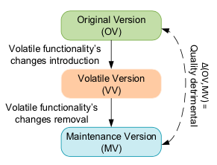
Assessment experiment
Assess software quality and developers’ perception of the development process for VFs removal
VF approach vs. Ad-hoc approach
Independent groups of participants
Ad-hoc approach: 17
VF approach: 14

Slide 24
Assessment results
a) Is Ad-hoc approach more prone to have application external quality issues?

Slide 25
Assessment results
b) Is application’s internal quality more negatively affected by Ad-hoc approach than VF approach?

Slide 26
Assessment results
c) Does VF approach requires less time than Ad-hoc approach?

Slide 27
Assessment results
d) Is the developers’ confidence affected by VF approach?
(*) Answered just by VF approach group

Slide 28
Assessment results
d) Is the developers’ confidence affected by VF approach?

Slide 29
Conclusions
Clear need to count with an alternative to deal with the emergence of VFs within Web Applications
The proposed approach provides solutions to cover the whole life-cycle of VFs in Web applications
VF approach can be useful and applied in a wide range of applications
VF Framework has been taken into practice and has been satisfactorily proved with the implementation of prototypes
The use of VF Framework during the experiment showed to:
Avoid introducing errors
Save time and effort
Improve the developers’ experience
Be accepted by impartial developers

Slide 30
Future work
Development of more prototypes with different technologies
Deeper analysis on the impact of VFs on persistence layer and database
Consolidation of a solid and mature Framework that can be positioned and used by the community
Implementation of tools for users to create their own activation and deactivation rules easily

Slide 31
Q & A

